Slide 1

Stress Detection
using wearable sensors and machine learning

Slide 2

Under Supervision Of : DR .Prof/ Ibrahim sadik
Project Done By:
Gerges Marzouk Nasry
2. Fady Bakheet Louka

Slide 3
CONTENTS
CONTENTS
01
02
03
INTRODUCTION
WESAD DATASET
WHAT THE PAPER DID?
04
05
06
WHAT WE DID
CONCLUSION
REFERENCES

Slide 4
01
INTRODUCTION
Mental stress has become a growing concern due to its impact on health and productivity. Traditional methods of stress detection, such as questionnaires or interviews, are often subjective and not suitable for continuous monitoring. With advancements in wearable technology, it's now possible to collect real-time physiological data that reflect a person's stress levels.
Wearable sensors—such as smartwatches and fitness bands—can measure signals like heart rate, skin temperature, electrodermal activity (EDA), and motion (via accelerometers). These physiological signals change in response to stress, providing valuable input for stress detection.
Machine learning (ML) algorithms can analyze these sensor readings to automatically identify patterns associated with stress. By training ML models on labeled datasets (e.g., with stressed vs. non-stressed states), we can build systems that accurately predict mental stress in real time. This approach enables non-invasive, continuous, and objective stress monitoring, which can be integrated into health applications for early intervention and improved well-being.

Slide 5
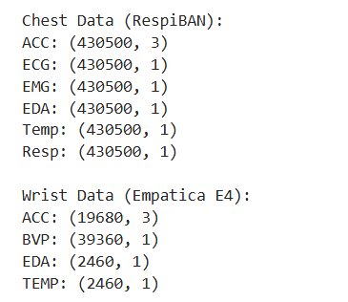
02
WESAD DATASET
WESAD :- WEarable Stress and Affect Detection
15 subjects participated in a lab study involving different emotional states: (baseline, stress, amusement, meditation).
Data format
Raw sensor data was recorded with two devices: a chest-worn device
(RespiBAN) and a wrist-worn device (Empatica E4).
RespiBAN:- measured 6 types of signals.
Empatica E4:- measured 4 types of signals.

Slide 6
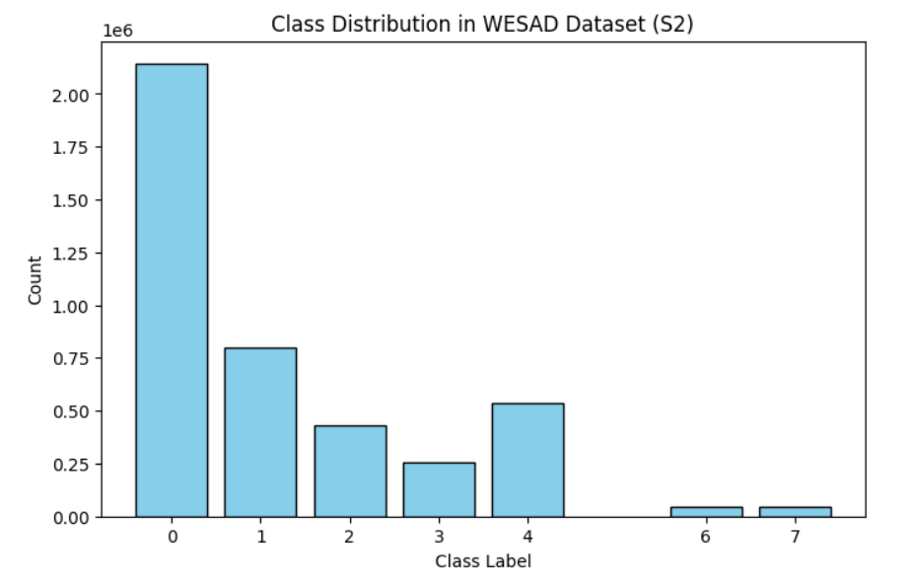
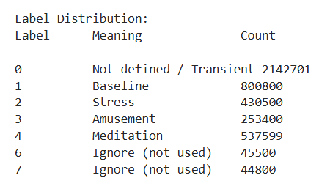
02
WESAD DATASET
Sessions:
transient, baseline, stress, amusement, meditation.
Labels in label field (numerical codes):
0 = undefined/transient, 1 = baseline, 2 = stress, 3 = amusement, 4 = meditation, others.
as shown label 5, 6, 7 missed or ignored becouse they are not participate with big amount in all subjects not this subject only.

Slide 7
03
WHAT THE PAPER DID?
1.Dataset (WESAD):
The study uses the WESAD dataset, which includes data from 15 people wearing two devices: RespiBAN (chest) and Empatica E4 (wrist), collecting 14 biosignals during different activities (baseline, amusement, stress, meditation, recovery).
2.Signal Processing Techniques:
Raw biosignals are processed using three techniques—Fast Fourier Transform (FFT), Cube Root (CR), and Constant Q Transform (CQT)—to turn them into frequency-based data that the CNN can use.
3.CNN Model:
The CNN is the deep learning model that takes the processed signal data and learns to classify stress states (e.g., Stress vs. Non-Stress, or distinguishing between baseline, stress, amusement, meditation, recovery).
4.Training Strategy:
The CNN is trained using a method called Leave-One-Subject-Out (LOSO) cross-validation, with 10 epochs, a batch size of 50, and the RMSprop optimizer. Hyper-parameters are tuned to ensure the model works well for new people.

Slide 8
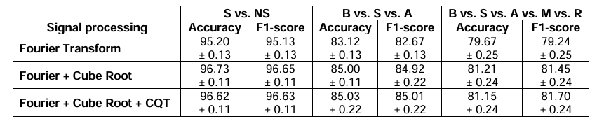
03
WHAT THE PAPER DID?
5.Evaluation and Results
The model is tested to see how well it detects stress. It gets:
96.62% accuracy for spotting stress vs. non-stress (very good!).
85.03% accuracy for separating baseline, stress, and amusement.
81.15% accuracy for all five states (harder task, still good).
The best results come from combining all signal processing tricks (FFT, CR, CQT).

Slide 9
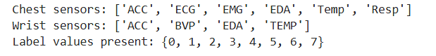
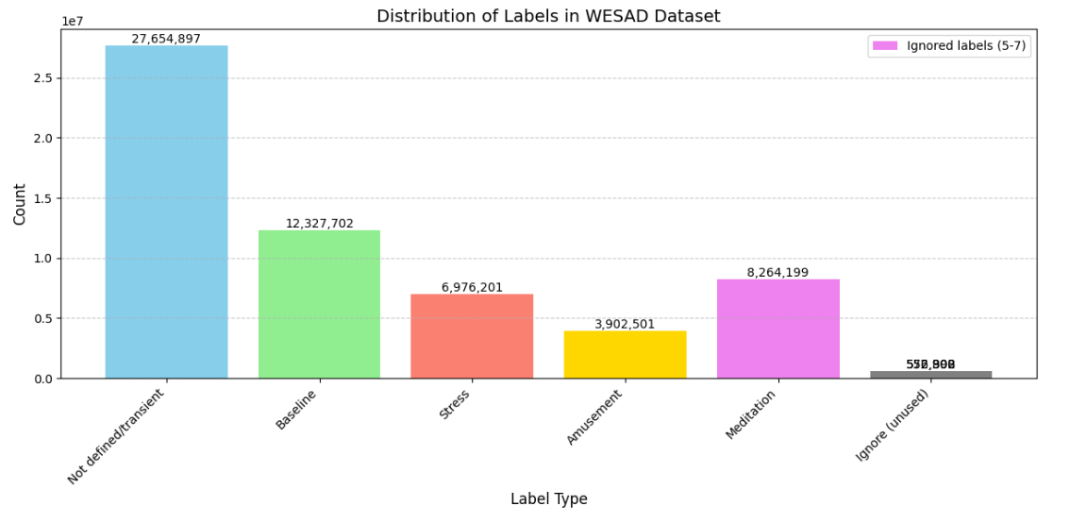
04
WHAT WE DID // procedure
1. Loading the data
At the begining we tried to read the data to know how it looks like, and we also known from this process the labels and signal types in the files.

Slide 10
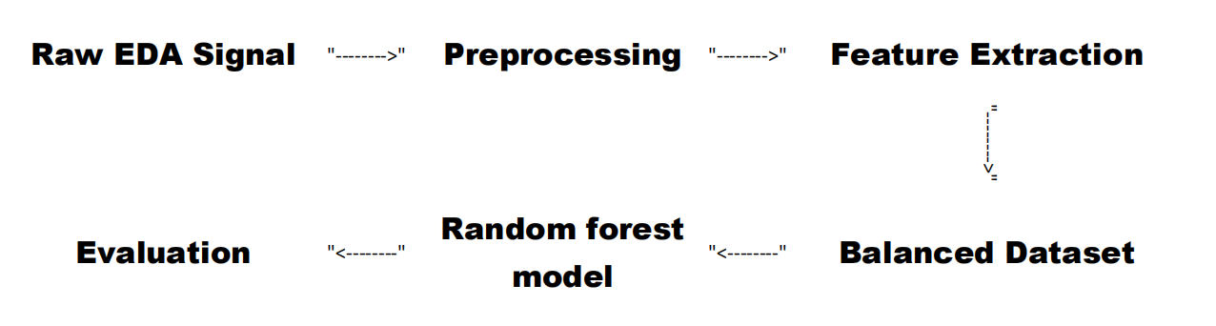
04
WHAT WE DID // PROCEDURE
2.Methodology Overview

Slide 11
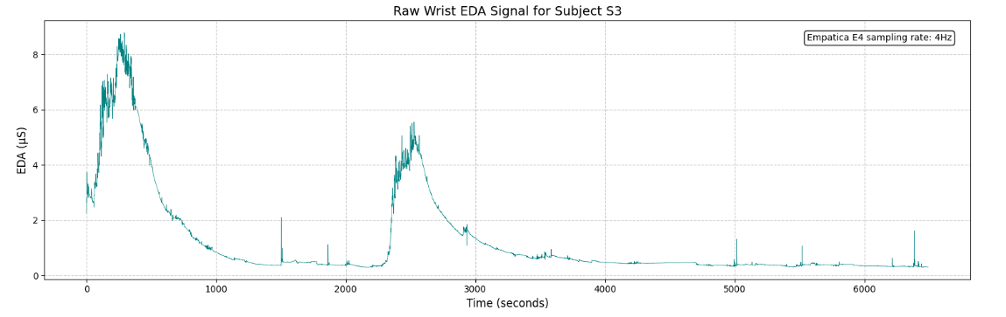
04
WHAT WE DID // procedure
A.Raw EDA (GSR) Signal On Wrist
EDA: measures the electrical conductance of the skin, which varies with its moisture level. This moisture level is influenced by sweat gland activity, which is controlled by the sympathetic nervous system. Therefore, EDA is a strong indicator of psychological or physiological arousal.

Slide 12
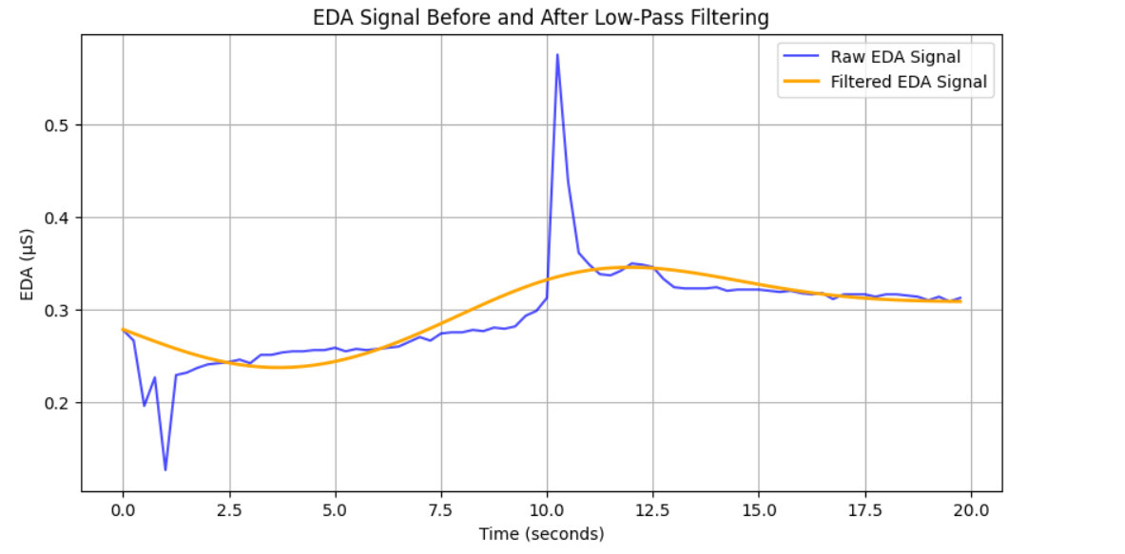
04
WHAT WE DID // procedure
B.Preprocessing:
We use a low-pass filter to smooth out the GSR signal. The code sets it to focus on slow changes (0.1 Hz cutoff) since stress signals don’t jump around super fast.
This makes the data way clearer for analysis. We even plot the raw signal next to the cleaned-up version to show how much better it looks.

Slide 13
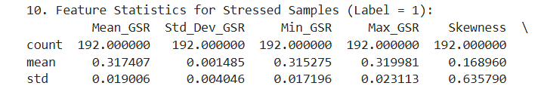
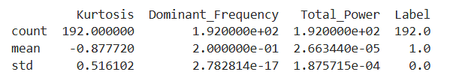
04
WHAT WE DID // procedure
C.Feature Extraction from GSR Signals:
The code slices the signal into 20-second windows (80 samples at 4 Hz) to make sure we’re capturing meaningful moments.
Time-domain features (e.g., mean and standard deviation reflect signal amplitude and variability), and Frequency-domain features (e.g., dominant frequency and total power from Welch’s method indicate signal periodicity).
The extracted features: mean, standard deviation, minimum, maximum, skewness, kurtosis, dominant frequency, and total power.

Slide 14
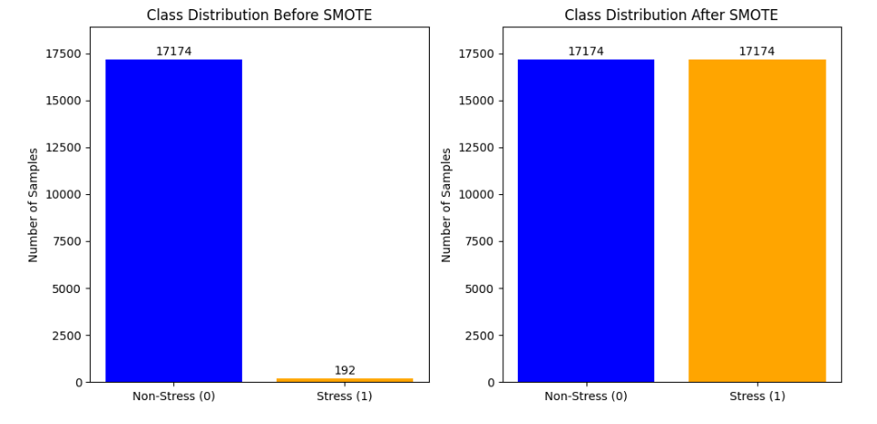
04
WHAT WE DID // procedure
D.Handling Imbalanced Data with SMOTE(Synthetic Minority Over-sampling Technique)
how the SMOTE work?
(from imblearn.over_sampling import SMOTE) generates synthetic samples for the minority class (stress) to balance the dataset.

Slide 15
04
WHAT WE DID // procedure
E.Random Forest Classification Model
Why Random forest ?
Ideal for signal analysis because it handles nonlinear patterns well, is robust to noise, and automatically identifies important features. It also performs reliably with small or imbalanced datasets and reduces the risk of overfitting.
The model parameters:
100 trees (MAX_TREES), max depth of 10, and balanced class weights to handle any residual imbalance.
Training & Testing
Data split: 70% training, 30% testing (TEST_SIZE = 0.3)

Slide 16
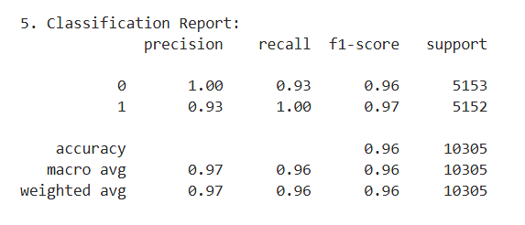
04
WHAT WE DID // procedure
F.Model Evaluation and Visualization
Training Accuracy: 0.9664
Test Accuracy: 0.9647
Classification report

Slide 17
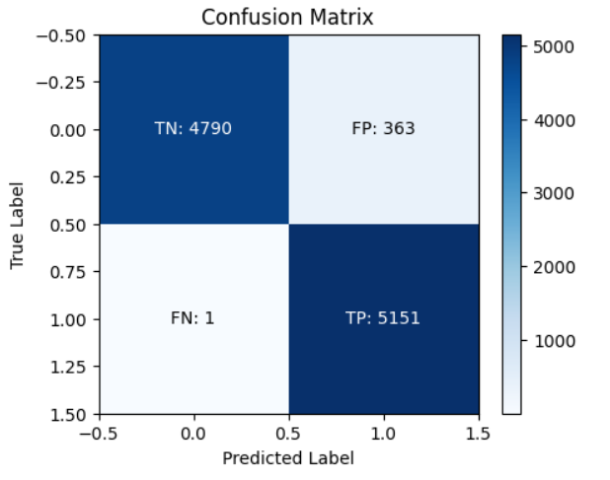
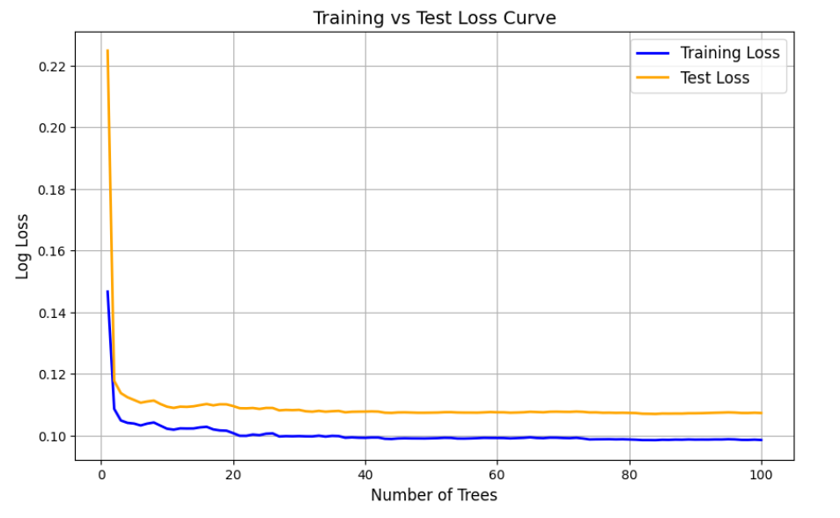
04
WHAT WE DID // procedure
Confusion matrix loss curve

Slide 18
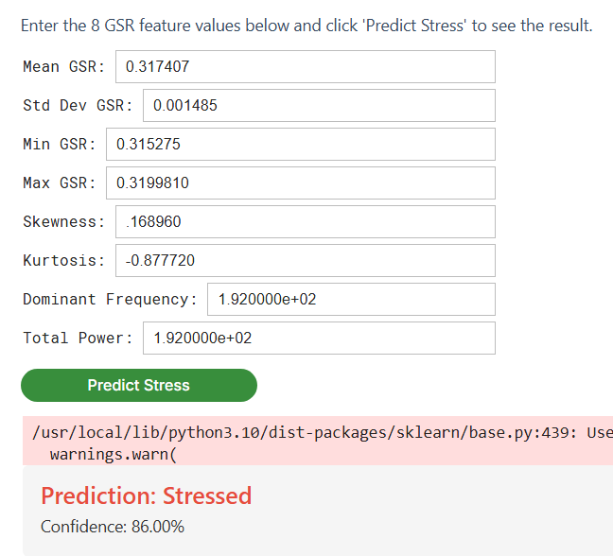
04
WHAT WE DID // procedure
3.Interactive Stress Prediction GUI
the interactive GUI built with (“ipywidgets”) for real-time stress prediction based on user-input GSR features.
the GUI components: eight input fields for GSR features, a “Predict Stress” button, and an output area displaying the prediction and confidence.
(red for stress, green for non-stress) and error handling for invalid inputs.

Slide 19
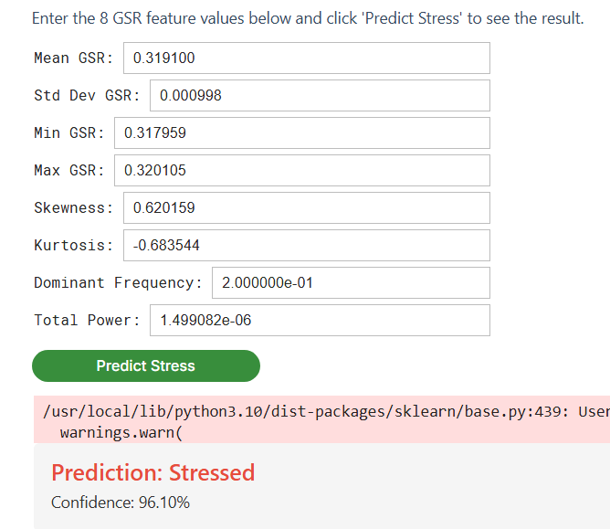
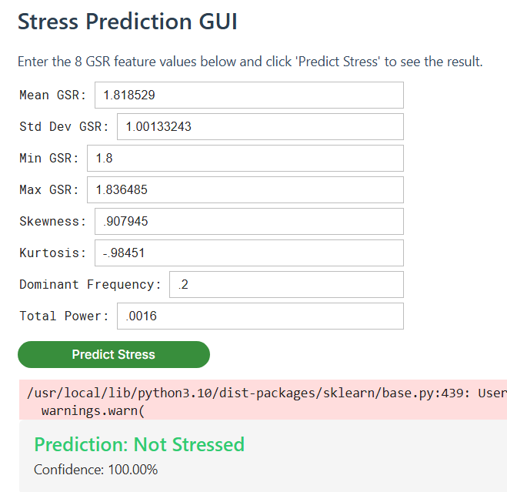
04
WHAT WE DID // procedure
3.Interactive Stress Prediction GUI

Slide 20
05
CONCLUSION
We built a system that uses GSR signals to detect stress with solid accuracy, backed by a robust dataset and a smart model.
This project shows how tech and biology can team up to help people live healthier, less stressful lives.
06
REFERENCES
https://oa.upm.es/78548/1/Stress.pdf
https://www.medrxiv.org/content/10.1101/2024.04.27.24305829.pdf

Slide 21
THANK YOU
ANY QYESTIONS?

